Slide 1
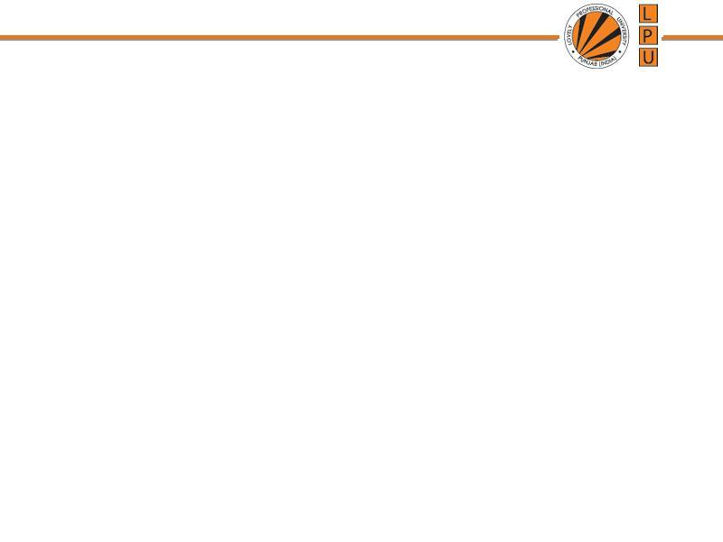
Chapter: Memory Management

Slide 2
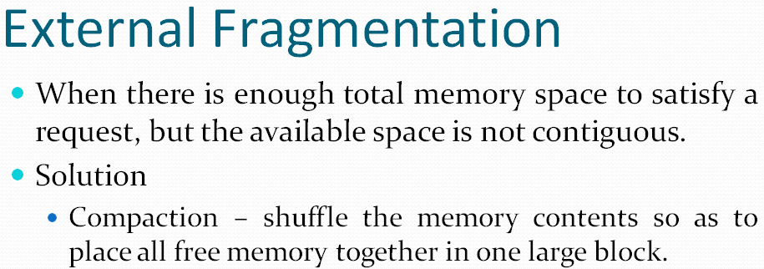

Slide 3
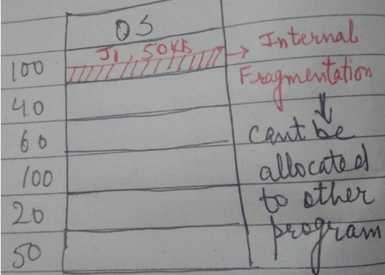
Partition Allocation
One method of allocating contiguous memory is to divide all available memory into equal sized partitions, and to assign each process to their own partition.
Partition Allocation Algorithms:
First Fit:
  Checks all partitions serially
  When partition with size = or > encounters, it is allocated for storage.

Slide 4
Partition Allocation Algorithms
  b) Best Fit: This approach will check all the free partitions and will allocate that free partition to a process which leads to minimum internal fragmentation.
  Disadvantage:
  Complexity is more
  Overhead to check all the partitions to find best suitable space
  c) Worst Fit: Allocate the largest memory hole

Slide 5
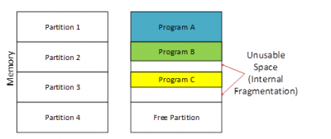
Fragmentation
  1. Internal Fragmentation: memory is allocated in blocks of a fixed size, whereas the actual memory needed will rarely be that exact size.
  Partition of greater size is allocated to process of small size, rest of the space of that partition is wasted.

Slide 6
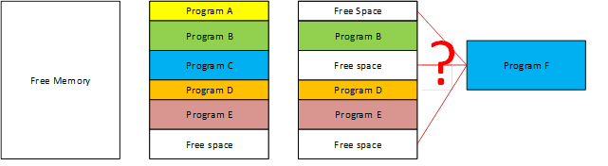
Fragmentation
  External Fragmentation: means that the available memory
  is broken up into lots of little pieces, none of which is big
  enough to satisfy the next memory requirement, although
  the sum total could.
  Due to non utilization of space, even space is empty

Slide 7
Fragmentation
  For Fixed sized partitions
  There is:
    Internal Fragmentation
    External Fragmentation
  For Variable sized partitions
    There is:
    External Fragmentation

Slide 8
Partition Allocation Table
  Contains information of space/ memory used by memory management module for allocation of memory to a process
  No. of partitions in main memory
  Size of each partition
  Starting location of partition
  Status of partition (allocated or free)

Slide 9
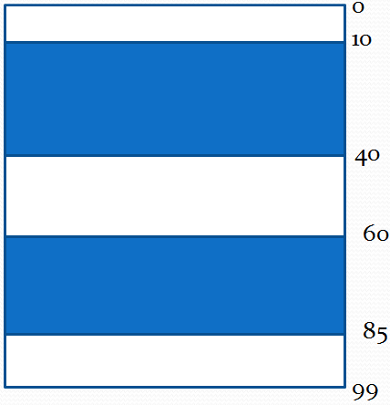
Memory Allocation - Example
  Given 3 free memory partitions of 10KB, 20 KB and 15KB ( in order) How would each of the first-fit, best- fit and worst fir algorithms place processes of 15KB, 10KB, 20KB and 5KB (in order)

Slide 10
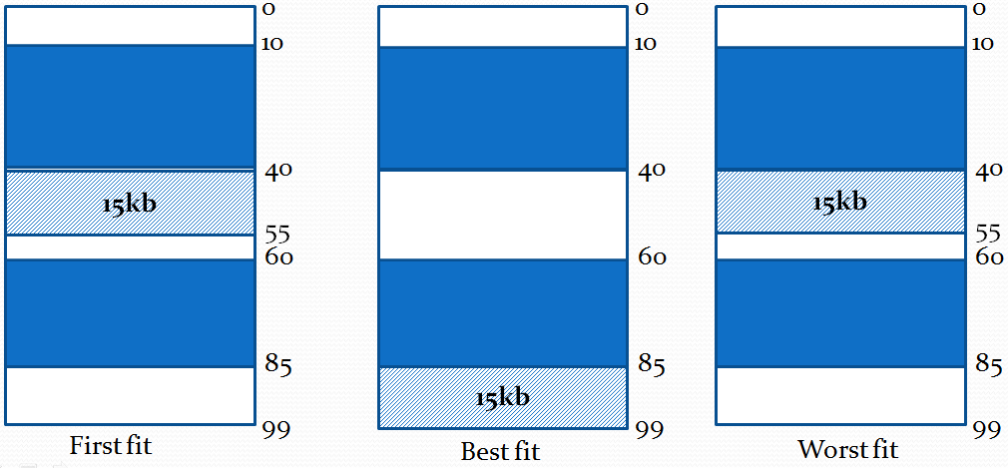
Memory Allocation - Example
  For 15KB

Slide 11
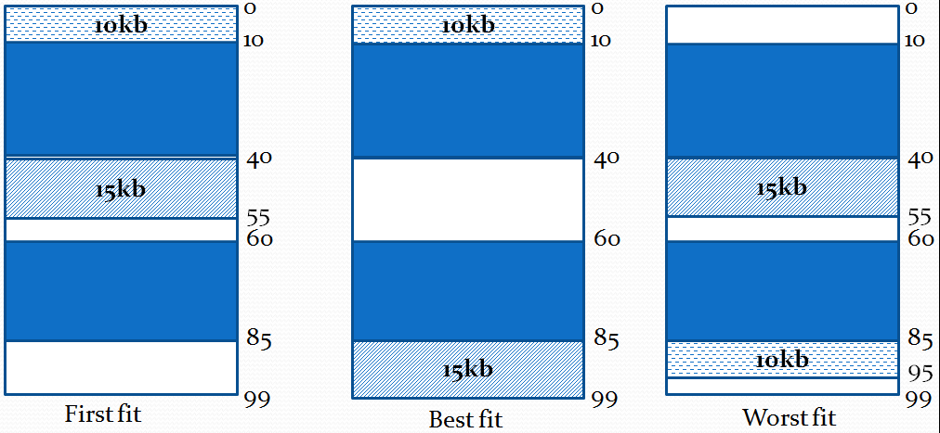
Memory Allocation - Example
  For 10KB

Slide 12
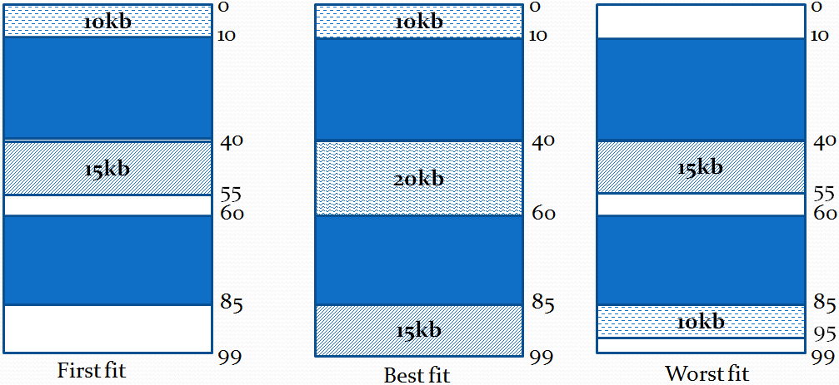
Memory Allocation - Example
  For 20KB

Slide 13
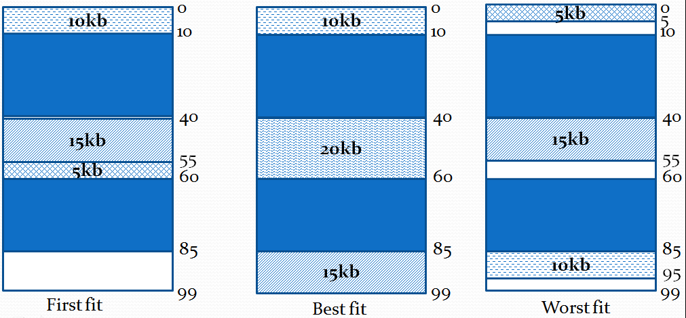
Memory Allocation - Example
  For 5KB

Slide 14
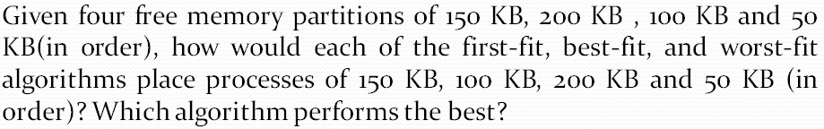
Memory Allocation - Example

Slide 15
Overlay
The main problem in Fixed partitioning is the size of a process has to be limited by the maximum size of the partition.
In order to solve this problem, solution used is called as Overlays.
The concept of overlays is that whenever a process is running it will not use the complete program at the same time, it will use only some part of it.
whatever part you required, you load it an once the part is done, then you just unload it, means just pull it back and get the new part you required and run it.

Slide 16
Overlay
“The process of transferring a block of program code or other data into internal memory, replacing what is already stored”.
overlay is a technique to run a program that is bigger than the size of the physical memory by keeping only those instructions and data that are needed at any given time.Divide the program into modules in such a way that not all modules need to be in the memory at the same time.

Slide 17
Overlay
Keep only those instructions and data into the memory that are needed at some time.
Overlay of instructions or data is needed when process is larger than amount of memory allocated to it.
It is implemented by user, No special support is needed from the OS.
Complex to implement.

Slide 18
Paging / Paged Memory Management
  Paging is a memory management scheme that allows
  processe’s physical memory to be discontinuous, and
  eliminates problems with fragmentation by allocating
  memory in equal sized blocks known as pages.

Slide 20
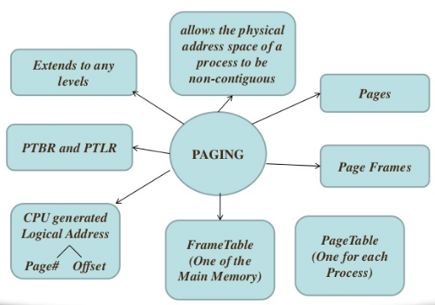
Paging

Slide 21
Paging / Paged Memory Management
  Every process is divided in to number of pages
  Memory is divided into partitions whose size is same as page size : frames
  Each frame has frame no.
  Page size is same as frame size
  Put any page in any free frame
  Paging allows non-contiguous memory allocation
  Page numbers, frame numbers and frame sizes are determined by the machine architecture
  Paging leads to Internal Fragmentation
  Pages size and Frame size is always in powers of two

Slide 22
Paging / Paged Memory Management
  CPU generates logical address and put the pages into random frames
  Mapping is required to map which page is stored in which page number
  From frame no. physical address could be found

Slide 23
Paging / Paged Memory Management
  Physical address space of a process in non- contiguous
  Implementation:
    Frames: Fixed sized blocks of the physical memory
    Pages: Fixed sized slots of the logical memory
  When a process is to be executed, its pages are loaded into any available memory frames.
  Page Table: is a data structure. Used to translate logical address to physical address
  CPU generated logical addresses to fetch the instructions.

Slide 24
Address Translation
  Address generated by CPU is divided into:
  a) Page Number (p): used as an index into page table, which contains base address of each page in the physical memory.
  b) Page Offset (d): combined with base address to define physical memory address that is sent to the memory unit.
  Actual address of any byte in page or frame (Position of instruction in page or frame)
    Address of physical memory, where page resides.
    The number of bits in the offset determines the maximum size of each page, and should correspond to the system frame size.

Slide 25
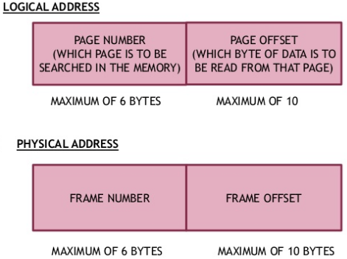
Address Translation

Slide 26
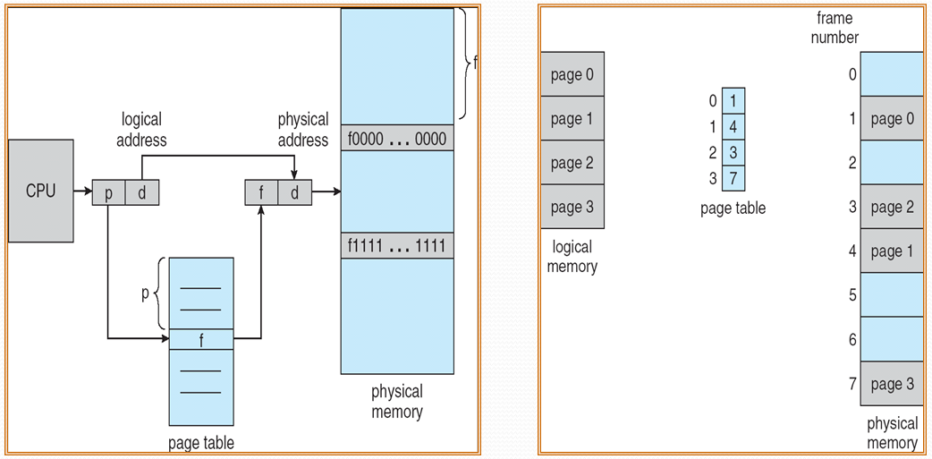
Address Translation

Slide 27
Translation of Address to memory
  How many address combinations can be generated from bits:
  1 bit → 2^1=2 i.e 0 or 1
  2 bit → 2^2=4 i.e 00,01,10,11 ……..so on
  n bits → 2^n combination of address locations can be generated.
  If we have n bit address, and system is byte addressable (every location/partition is of 1 Byte) it will support memory of:
  2^n x 1Byte

Slide 28
Translation of Address to memory
  Translate n bit address to memory
  Q1. Assume memory is byte addressable and address is of size 14bit. Compute size of memory.
  Ans
  Using 14 bits how many address combinations we can generate? 2^14.
  2^4 x 2^10 =16 K *1 Byte
  = 16KB

